Slide 1
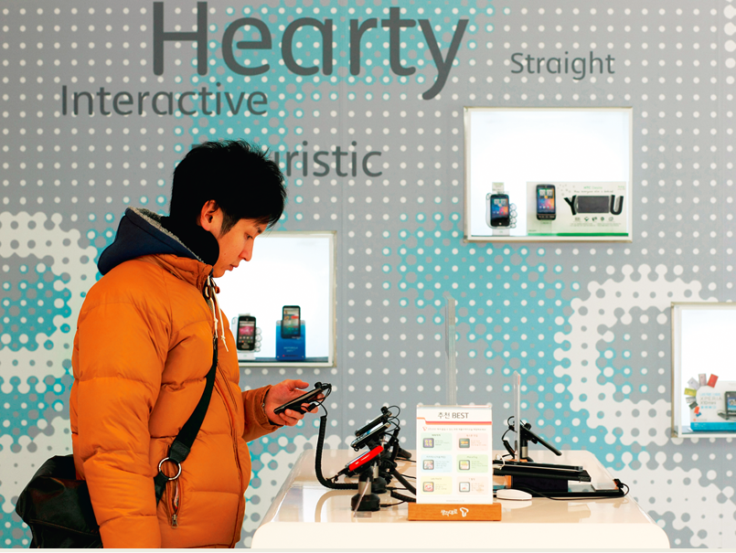
Choice: The Heart of Economics.
Economic Decision.
She must choose.
And her choice affects others.
Wants vs. Needs
What economic decision that you made today?

Slide 2
What is Economics?
A Social Science
Economic Models: Correlation
Economic Policy Tool:
Personal
Business
Government
Notes:
Economics is part of Social Science, the study of human behavior. Economics is the study of how people allocate their limited resources to satisfy their nearly unlimited wants.
Economic Models: look into the correlation among factors. For example: your decision to buy a new smartphone would depends on how much money that you have, what budget that allows you to spend, how much the prices, what features that you need, etc.
Examples of economic decisions in your personal life:
1) Your decision to be a student at this campus depends on a series of factors too, think about it, write down 5 factors. These will help you motivate your study. It also depends on how much will you spend throughout your study and how much you would gain in the future throughout a lifetime career.
You want to buy a car: imagine what steps you are going through, checking your budget and income sources, what type of cars that fit into your budget and needs, model and gas efficiency, cash or loan, brand new or used, etc.
Economic decision in Business:
When you want to start a new business, you might want to consider your capital sources (a bank loan, a kickstarter project, venture capitalist, your parents?); where to locate it (in your basement, garage, or lease a studio, or office); who to partner with, who to hire, and how much the costs of the initial setting. Five-year plan, 10-year plan; checking consumer-base, according to your product; how to channel the product, etc.
Dealing with Government, all businesses have to register for license, and eventually pay taxes. Regulation in the industry that might apply to you, some tax exemptions/deductions, etc.
Economic Policy is also used by the Government with the goal of a stable economy. Balance between tax revenue and government spending, stimulate job creations, reduce job losses, stable inflation rate, interest rates, and money supply in the society. Instability in economy might lead to political instability, and vice versa.

Slide 3
Economics
Thomas Malthus, 1800
Population Growth vs. Food Growth
Technology, Efficiency, & Productivity
Pessimistic View v. Optimistic View
Limited Resources
Scarcity, Allocation of Resources
Diamond-Water Paradox
Microeconomics and Macroeconomics
Classical: Adam Smith, 1776:
Invisible Hand, Specialization
Keynesian: James Maynard Keynes, 1930s:
In the long run, everyone’s dead
Notes:
Thomas Malthus, a priest, using economic model, predicted that there would be food scarcity because population grew exponentially while the food supply grew arithmetically, by much slower growth rate. Disaster? Turned out that his prediction was wrong. He did not take into account human resiliency and resourcefulness. Technology in food production has multiplied the production. The use of mechanization approach in food growing leads to higher efficiency, and disaster was averted.
Malthus’ view represents the Pessimistic view about the future. It also shows that a model that was based on the past data might miss the important ingredient/factor that emerged later.
In 2008, we experienced a Housing crisis, that people called the Great Recession (less harsh than the Great Depression in 1930s, yet it had impact the nation for years, and even across the borders). This crisis was a result of over-Optimistic view. Years before that, people have optimistic view about the Housing market, all researches modeled that investment in housing would yield 10% a year continuously. More and more people bought houses, their second house, third house, fourth house, fifth house, even when money to pay for the monthly mortgages were not enough.
Every resources are “limited”: even fresh water, fresh air. Even in Washington state that are seemingly abundant with water and greenery, fresh water and fresh air are still a concern. Scarcity means that demand is more than the supply, and therefore people have to allocate the resources.
Diamond-Water paradox: it’s a paradox, because diamond, that is useless (but pretty!) costs a lot, while water that is significant to human lives cost much cheaper. These are examples of the result of DEMAND and SUPPLY.
Economics as a study is divided into two sub-fields:
-Microeconomics is the study of the individual units that make up the economy, for example, the consumers of milk, pizza, nike shoes, etc.
-Macroeconomics is the study of the overall aspects and the workings of an economy, and we look into the “aggregates”, the larger measurements or indicators, such as inflation, growth, employment, interest rates.
It does not means the two subfields are totally separated, in fact, they are both weaved into each other, for example: consider a worker who gets laid off and becomes unemployed. Since only one worker is laid off, this is a microeconomics issue. If many workers had been laid off and it becomes a “systemic” issue that happens throughout industries, this led to a higher unemployment rate, it would be a macroeconomics issue.
Modern Economics was started by Adam Smith, Classical Economic. In his book, “The Wealth of the Nation”, 1776, he wrote that an economy left on its own, without much of government interference, will be able to sort things out, as if there’s an “invisible hand”. The reason is that everyone in the society have incentives to better themselves, using the opportunities or creating opportunities, to make themselves better off. He also wrote about Specialization, example, in the factory, when workers are trained to specialize into each subtask, the production will improved its efficiency.
Classical Economics suggested for a “Laissez-faire” economy, a small government (less government intervention), but Keynesian Economics suggested for a bigger government (more government intervention, especially during an economic recession).
Keynesian Economics is a response to The Great Depression that started in 1929 throughout 1940s. High unemplyment (25%), one in four workers lost their jobs. Keynes suggested that during a recession, businesses reduced employment, because there are no demand or lack of demand for their products, due to uncertainty. Everyone in the society seems to be in the “waiting” mode, and a recession might even gets deeper and deeper, and for longer period. Keynes said that Government could not wait for the “invisible hand” to sort things out, and the Government should use government policies to stimulate the economy, encouraging firms to start hiring again, encouraging households to buy goods, through various programs.

Slide 4
Economic Issues
Self-interest v. Social Interest
Globalization
Information Age
Climate Change
Social Security Time Bomb
Notes:
Look at these economic issues: each has both positive and negative impact to us and to society.
Think of one example each that applies to you.
Self-interest v. Social Interest
Globalization
Information Age
Climate Change
Social Security Time Bomb

Slide 5
The Five Principles Common Ground – Economic Way of Thinking
Incentives
Trade-Offs
Opportunity Costs
Marginal Benefits – Marginal Costs
Trade Creates Value

Slide 6

1. Incentives
Choices are necessary
because
resources are scarce.
People responds to Incentives.
Positive and negative.
Direct and indirect.
Notes:
Scarcity of resources forces us to make choices. Scarcity happens when demand is larger than what’s available.
To encourage people to make the right choices, a government can use policies as incentives towards certain outcomes that are expected to better the society.
Incentives are factors that motivate a person to act or exert effort. The choice to study for an exam instead of spending time with your friends is based on the belief that doing well will provide with a greater benefit not just for a good grade by the end of a term, but with much longer impact to the future.
As an academic, I believe that “learning is its own rewards”, but as a teacher I always created incentives; positive or negative incentives. Direct or indirect incentives.
Positive incentive: year-end bonus for workers that work well, achieve targets, etc.
Negative incentive: speeding ticket or fine will discourage people from driving too fast
Direct incentive: easier to recognize; when a gas station lower the price, customers that usually do not stop there will buy from them.
Indirect incentive: not easy to recognize, and usually comes in the form of “unintended consequences”; the lower price of gas work as an indirect incentives that encourage consumers to use more and more gas, and the unintended consequences are more pollution, green gas effect, etc.
Another example: unemployment benefits is a policy to help ease out the hardship to those who lost jobs during recession, temporarily, families could still buy daily necessities and keep a stable life; unintended consequences: it provides dis-incentive to seriously look for jobs.
Incentives and Innovation: US government ensures that the patent system and copyright laws guarantee investors a specific period of time in which they can exclusively sell their work. This encourages innovation by creating a powerful financial reward for creativity. Maintaining the right rewards, or incentives, for hard work and innovation is essential for advancing our society.
Incentives are everywhere.
The movie, “Deep Throat” about watergate scandal during Nixon 1970s, a secret source the reporter: “Follow the money”.
Look for incentives around you, and tell the class what they are.

Slide 7

Incentives and Performance
People usually respond to incentives, exploiting opportunities to make themselves better off.
In the United States, restaurant customers have the option of adding a tip to the restaurant bill. In much of Europe a tip is added automatically.
Where would you expect waiters to be more attentive?

Slide 8
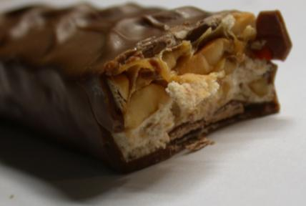
2. Trade-offs
Trade-off: comparison of the costs and the benefits of doing something.
Each bite of the candy bar has costs and benefits.
Beijing 2008 Olympics: Clean Air or Economic Prosperity?
What kind of trade-off that you did lately?
Notes:
In a world of a scarcity, each decision incurs a cost. Even time is a scarce resource, there are only 24 hours a day
Trade-offs are an important part of a decision.
Going to college? Or Getting a job?
Clean environment or higher income level for a nation?
Choosing one thing over another involves thinking of costs and benefits.

Slide 9
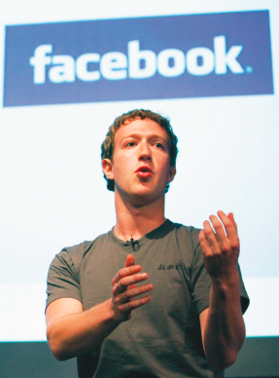
3. Opportunity Cost
Opportunity cost:
what you must give up in order to get something.
Mark Zuckerberg understood the concept of opportunity cost—and dropped out of Harvard.
What is your opportunity cost of attending classes?
Notes:
Go to a concert or going hiking? The cost of going hiking is the lost opportunity of going to the concert.
No matter what choice you make, there is an opportunity cost, or next-best alternatives that must be sacrificed in order to get something else.
Mark Zuckerberg, Bill Gates, dropped out of Harvard, to pursue their dream, because they considered the opportunity cost.
Mick Jagger left London School of Economics, for joining the Rolling Stones.
Given their sucesses, it is hard to fault their decisions.

Slide 10
Got a Penny?
Sixty years ago, a penny was equivalent to 30 seconds worth of work—it was worth saving a penny if doing so took less than 30 seconds.
Today, wages have risen along with overall prices, a penny is now equivalent to just over 2 seconds of work—and so it’s not worth the opportunity cost of the time it takes to worry about a penny more or less.
The rising opportunity cost of time in terms of money has turned a penny from a useful coin into a nuisance.
In April 2012, The Central Bank of Canada stopped printing (not the circulation) new penny coins.

Slide 11
Describe the opportunity costs
Attend college instead of taking a job
foregone earning of potential job, valuable job experience;
on the other hand, there are benefit of having a college degree,
with the possibility of higher earning in the future.
2. Watch a movie instead of studying for exam
3. Ride the bus instead of driving your car
4. More people choose to get graduate degrees when the job market is poor.
5. There are more parks in suburban than in urban areas.
6. Fewer students enroll in classes that meet before 10:00 am.

Slide 12
4. Marginal Thinking: Benefits-Costs
“How much” is a decision at the margin.
Weighing the extra benefits
against the extra costs.
If I eat one cookie each night before sleeping, how many extra pounds would I gain in a year?
If I study one more hour each night, I would increase 0.5 point in my GPA.
What marginal thinking that you have done lately?
Notes:
Marginal thinking requires you to evaluate whether the benefit of one more unit of something is greater than its cost. Marginal analysis is a useful process to break down decisions into smaller parts, and help us make better decision. A person will decide on doing something when he considers that the marginal benefit outweigh the marginal cost.

Slide 13
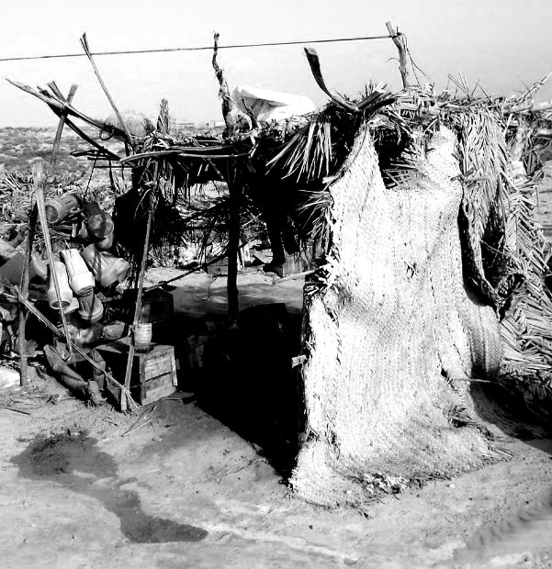
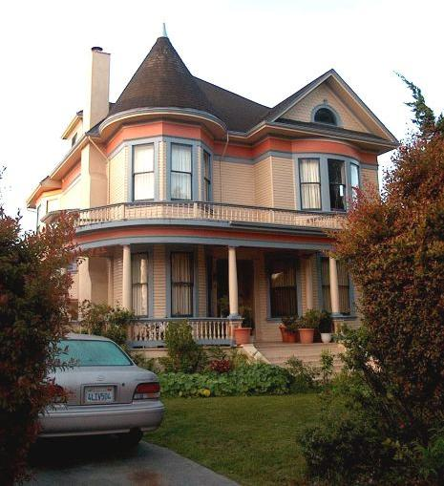
5. Gains from Trade
Trade allows us all to consume more than we otherwise could.
Comparative Advantage, based on Specialization
Notes:
In a market there are buyers and sellers, they exchange goods and services. Markets bring together those two parties.
Trade is a voluntary exchanges of goods and services between two or more parties. The two parties will voluntarily do trade when they both consider that they will be better off. Therefore trade could only benefits both parties.
Trade allows people and countries to specialize in doing what they are best at. Trade helps create additional growth of economy through specialization. A house builder do not have to worry about building each part or component of a house, he can just buy those from specialized producers, put them together.
Individuals, such as a doctor, teacher, plumber do not have to worry about how to do everything by themselves. Specialization means that a person or a country has comparative advantage over a production of something (goods or services), it can produce at a lower opportunity cost.

Slide 14

Adam Smith on Specialization
Specialization: the situation in which each person specializes in the task that he or she is good at performing.

Slide 15

Equity vs. Efficiency
Scarcity of Space
Personal needs v. Social needs
Equity: a condition in which everyone gets his or her “fair share.”
(There are many definitions of equity.)
Equity and efficiency are often at odds.
Equity trumps efficiency in disabled parking space offerings.

Slide 16
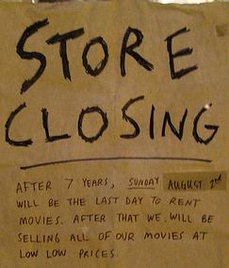
Economic Recessions: Business Cycle
During recessions, a drop in business spending leads to:
Less income,
less spending…
…and further drops in business spending, layoffs, and rising unemployment.

Slide 17
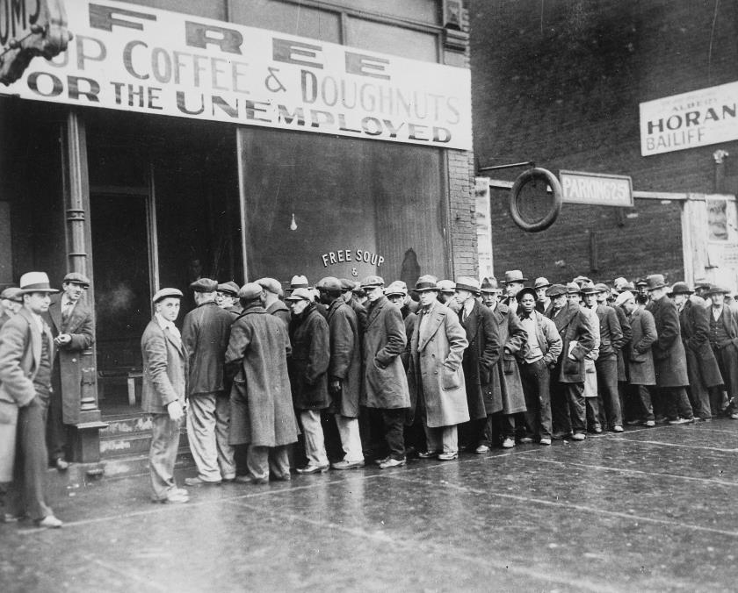

Government Policy
The U.S. government funded the WPA and provided almost 8 million jobs between 1935 and 1943.
In response to the Housing Crisis, American Recovery Act 2009

Slide 18
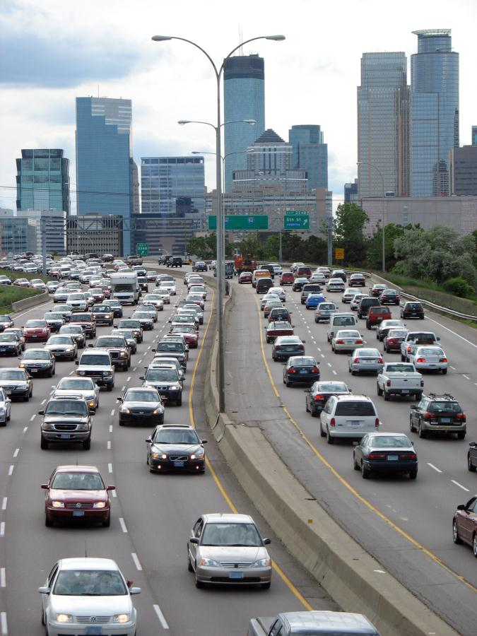
Work in pair. Write down your answer in a piece of paper, put both of your names.
The US Government drives up miles-per-gallon requirements: auto-emission and fuel economy standards will require up to 35.5 mpg by 2016, in order to limit the amount of CO2 emission. (source USA Today)
Discuss the situation in terms of the foundations of Economics: Incentives, Trade-offs, Opportunity Cost, Marginal Thinking, Trade; then answer the following questions:
What are two benefits of the new mpg requirements? Are these benefits in someone’s self-interest or in the social interest?
What are two costs associated with this new mpg requirements?
Provide another government policy that influence behavior, then give two benefits and two costs of this policy.

